Slide 1




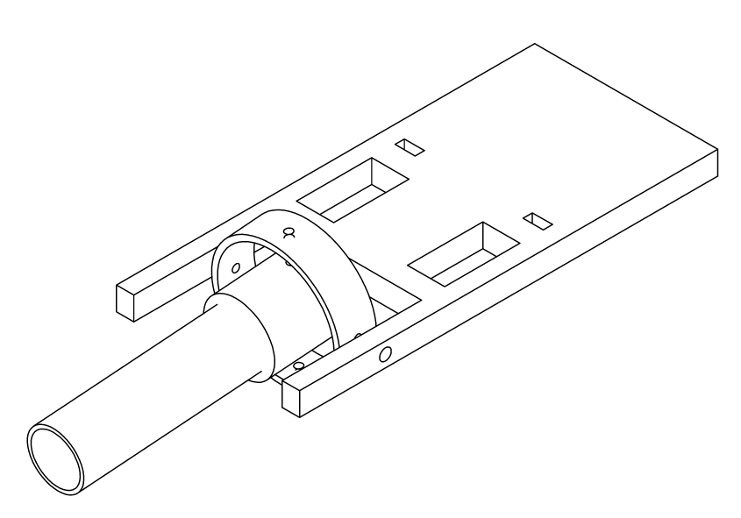
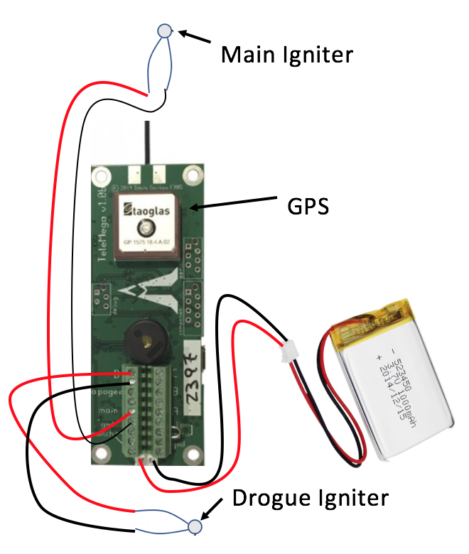
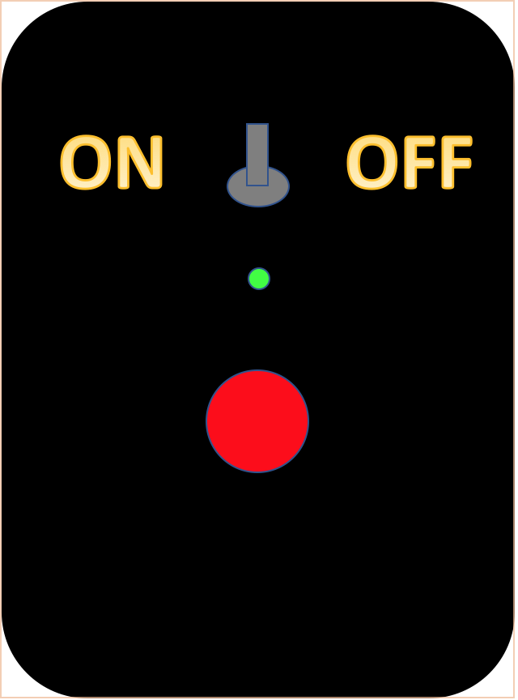
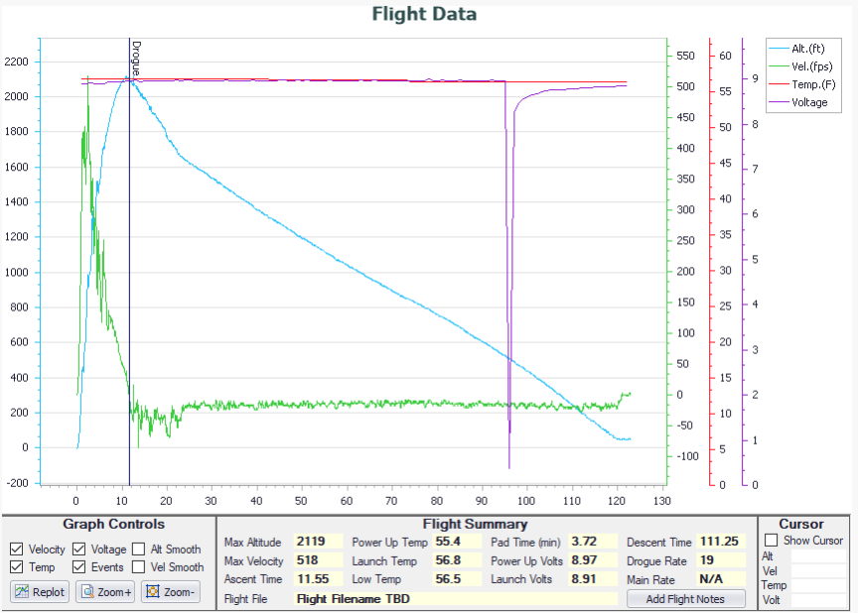
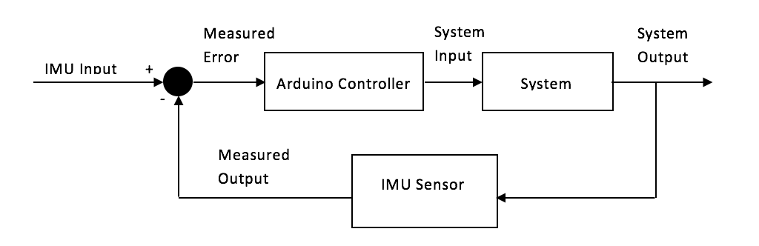
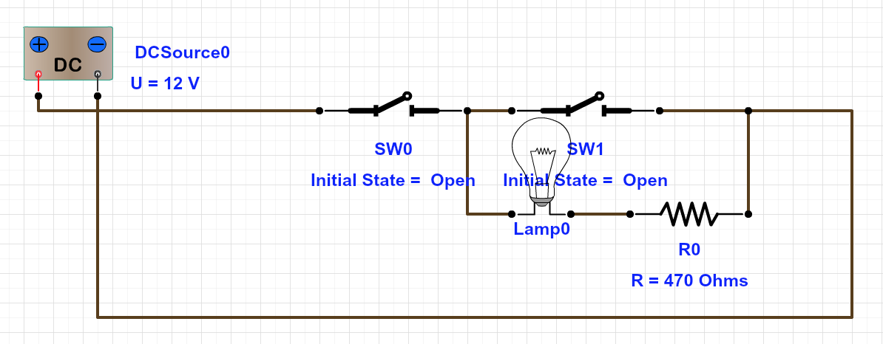
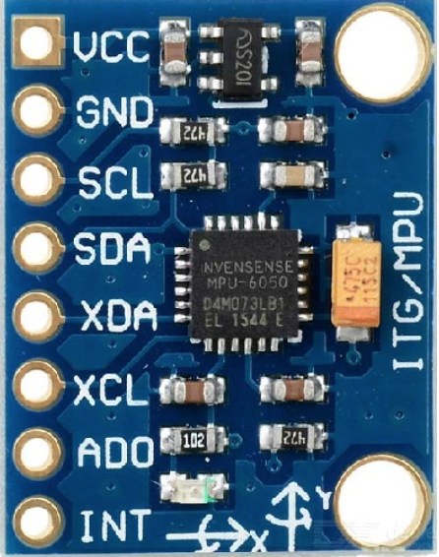
Daniel Nemr Advised by Dr. Pablo Yoon Department of Electrical and Computer Engineering
Project Overview:
SEDS is a a non-profit organization that empowers young students to participate in nationwide projects and events. The team has decided to enter this year’s University Student Rocket Competition (USRC), where a high power two-stage rocket will be designed and manufactured to reach the highest altitude against the opposition. This project mainly focuses on the electrical components associated with high-power rockets such as:
An electrical launcher
Stabilization system
Parachute deployment
Stabilization System:
The purpose of the stabilization system is to guide a rocket vertically after the initial liftoff of a rocket. The stabilization system has two main roles during the launch of a rocket:
To ultimately provide horizontal and vertical
stabilization
2. To control the engine’s thrust vector and
counteract the orientation of the rocket
Parachute Deployment:
The rules of the competition state that the two-stage high-power rocket must land safely and should be compatible for multiple launches. Parachute deployment is a dire part of this competition because manufacturing other rockets isn’t cheap due to the electronics and types of materials used. Ideally, the system must do 3 functions:
Deploy a drogue chute at apogee
Deploy a main chute at 500 ft. (or
any altitude found necessary to
reduce descent drift)
3. Sense when the rocket reaches
apogee, and the altitude when the
main chute deploys
Stabilization System Assembly:
The stabilization system was assembled using a 6-axis MPU6050 sensor, an Arduino Nano microcontroller, and two servo motors for the x and y axis of the engine’s thrust
The MPU6050 tells the Arduino which direction the rocket is facing
The Arduino then sends instructions on which way the servo motors should move
The servo motors are attached to x and y gimbals which control the direction of the engine’s thrust
All electronics are housed on
a customized acrylic chassis
An Arduino Nano is used because of
its compact size, compatibility,
and 16 MHz clock speed
Parachute Deployment Data:
The data below displays the following:
The rocket reached an
altitude of 2119 ft.
The drogue chute deployed
at apogee
3. There was a voltage drop at
roughly 500 ft. causing the
main chute not to deploy
Electrical Launcher:
Three purposes to the electrical launcher:
The launcher must deliver enough electrical current to ignite the pyrogen coated igniter, thus sparking the motor (at least 1.5 amps for one full second)
The launcher must include a
safety mechanism so that it is safe
for someone to prep the rocket for
launch
3. The launcher must guide
the rocket until it has
attained enough airspeed
for the stabilization system
to safely guide the rocket
Conclusions:
The USRC will be taking place in October of 2018, but there are conclusions that can be made from what has been designed and implemented so far:
The launcher provides enough current to ignite the pyrogen and start the engine
The stabilization system can implement gimbal thrusting, but testing must be done to verify amplitude improvement and stability.
Parachute deployment can deploy a chute at apogee and at 300 ft. while also being able to track the rocket during flight
Accelerometer Use (MPU 6050):
The MPU6050 is an accelerometer and gyroscope which reads the x, y and z axes for both implementations. The accelerometer was utilized for two reasons:
To sense the orientations in the x and y directions of
the rocket
2. To send the Arduino Nano the direction of the rocket
so the servo motors can counteract the orientation of the
rocket using gimbal thrusting

